Slide 1
CI cycle
45426: Teste e Qualidade de Software
Sérgio Freire
v2025-11-12

Slide 2
Learning objectives
DevOps in a nutshell
Explain the core concepts of Continuous Integration practice
See CI in action
Learn how CI can be integrated with a test management tool
How to analyze the results and its impacts in Jira
BONUS: How to overcome some testing challenges even with CI

Slide 3
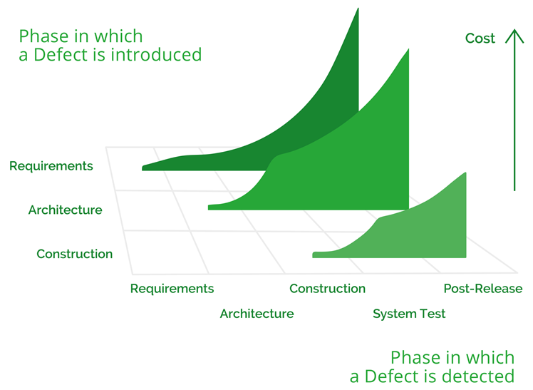
The cost of bugs
The cost of fixing bugs grows exponentially depending on the phase in which they are detected.
The fix cost also depends on the stage where bugs are initially introduced.
⇨ Test early
⇨ Test continuously
⇨ Avoid technical &
testing debt
(adapted from) Code Complete, Steve McConnell, 2004

Slide 4
Speed vs Quality
Are they real enemies?
These can help you out:
Agile
DevOps
Continuous Integration
Automated Testing
Continuous Testing
Continuous Delivery
Image by www.genalice.com
Release often, with confidence. Motivates the teams and makes customers happy.
4

Slide 5
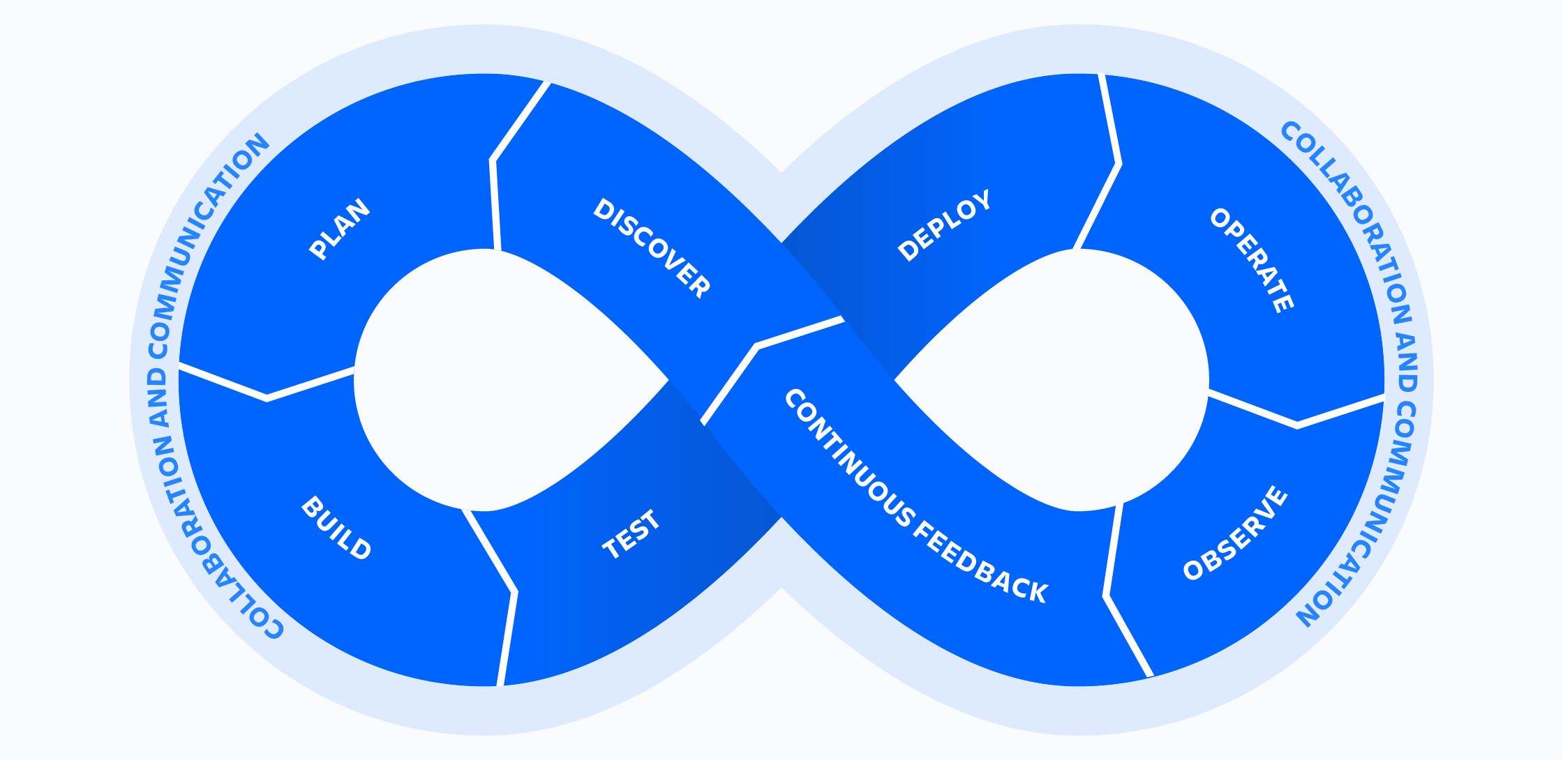
DevOps
Dev
Ops
Notes:
DevOps is a set of practices, tools, and a cultural philosophy that automate and integrate the processes between software development and IT teams. It emphasizes team empowerment, cross-team communication and collaboration, and technology automation.

Slide 6
Continuous Integration
Continuous Integration is a software development practice where each member of a team merges their changes into a codebase together with their colleagues changes at least daily. Each of these integrations is verified by an automated build (including test) to detect integration errors as quickly as possible.
Teams find that this approach reduces the risk of delivery delays, reduces the effort of integration, and enables practices that foster a healthy codebase for rapid enhancement with new features.
Martin Fowler

Slide 7



Continuous Integration
Code
Push changes to version control
Run tests
Merge
Build
Static analysis, etc
Commit

Slide 8



Continuous Integration
Commit
Push changes (e.g. to git)
[Merge]
Code
Analyse CI results
Checkout code
(if change is detected)
Run tests
Notify / make report
Build
Static analysis
Developer
CI tool
(e.g., Jenkins, GH actions, Bitbucket pipelines, TeamCity, Gitlab)

Slide 9
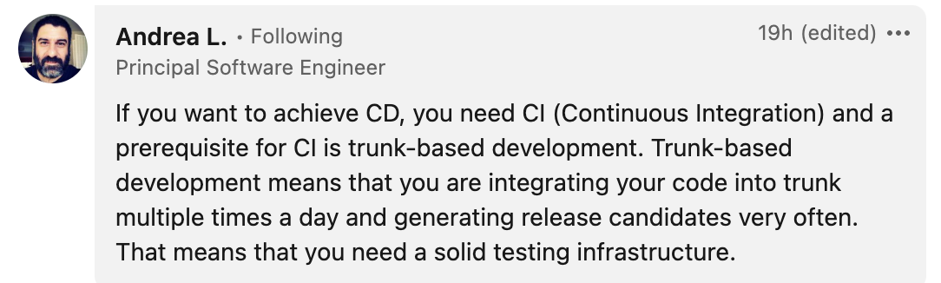
Where do we integrate to and how?
On ”main”/”master” branch directly
    Trunk-based development
Using other branches, that we then merge if “all” is OK
    GitHub flow (simpler) or Git flow
    NOTE: in this case, we need to have short-lived branches!

Slide 10

Build broken: who should fix it?
Usually, we follow the “You broke it, you fix it” rule.
However, we should work as a team and improve quality together.
Sergio Freire

Slide 11
Continuous Integration
Ok… we need to integrate often and continuously, and it involves test automation; got it!
But is testing just like a “phase” in the DevOps infinity loop??

Slide 12
When (and how) do we test in DevOps?
Whenever we implement the feature?
Before?
After?!
… and using just Test Automation during CI?

Slide 13
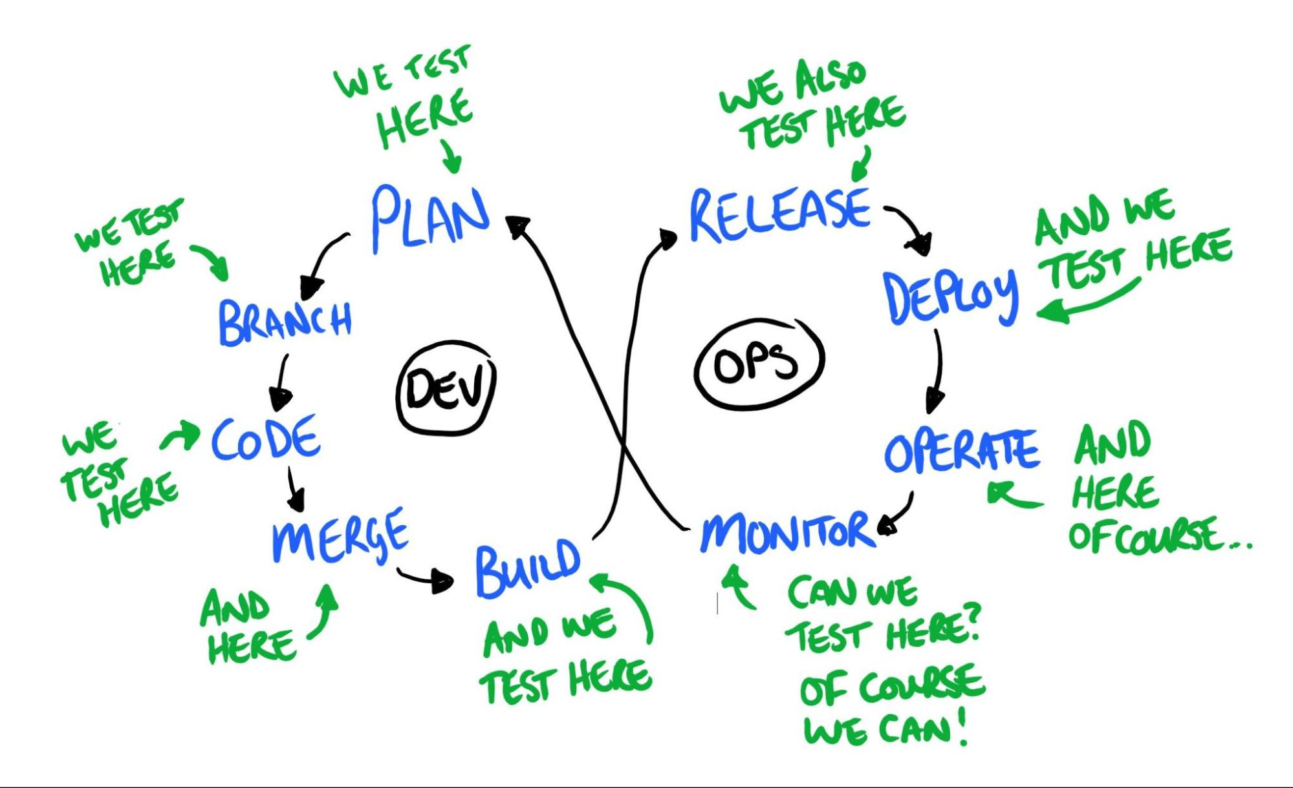
When do we test in DevOps?
Continuous Testing in DevOps model by Dan Ashby
https://www.linkedin.com/pulse/continuous-testing-devops-dan-ashby/
Sergio Freire
Notes:
https://www.linkedin.com/pulse/continuous-testing-devops-dan-ashby/
https://danashby.co.uk/2016/10/19/continuous-testing-in-devops/

Slide 14
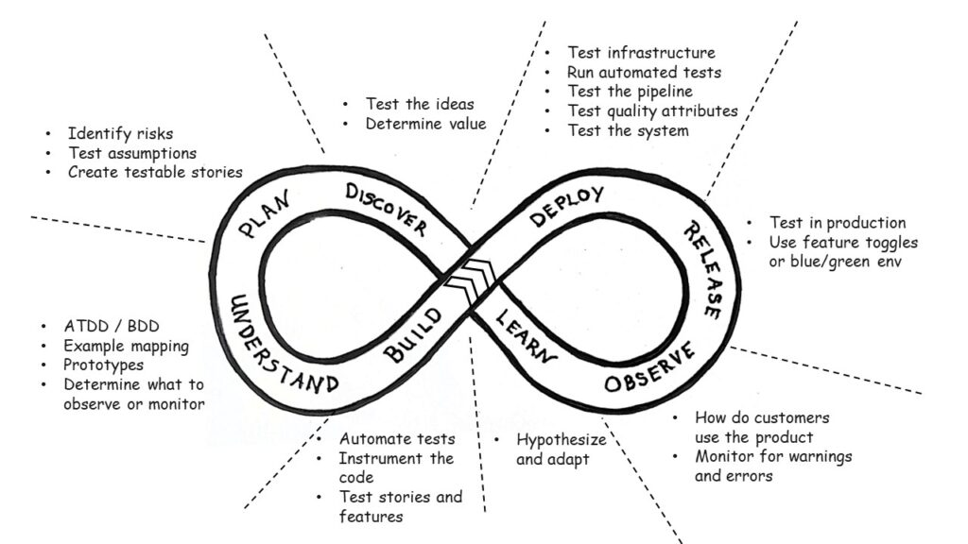
Holistic Testing (Agile Testing)
When we test, we need to consider all types of testing, not only the ones we think a tester is responsible for. It includes automation, exploratory testing, or any other type of human-centric testing. It involves the whole team, the product organization, and even the customer. We need to consider testing from a holistic point of view. - Janet Gregory
https://janetgregory.ca/testing-from-a-holistic-point-of-view/
Notes:
https://janetgregory.ca/testing-from-a-holistic-point-of-view/

Slide 15
Agile Testing
Collaborative testing practices that occur continuously, from inception to delivery and beyond, supporting frequent delivery of value for our customers. Testing activities focus on building quality into the product, using fast feedback loops to validate our understanding. The practices strengthen and support the idea of whole team responsibility for quality.
Lisa Crispin & Janet Gregory

Slide 16



Testing approaches?
Scripted testing
Test cases
Test automation
Exploratory
testing

Slide 17

Agile Testing and the testing approaches
Agile Testing
Essential for..
Avoiding regressions
CI/CD
Scripted Checks
Exploratory
Manual
Automated
Multiple types of tests, at different levels
Multiple frameworks & tools

Slide 18
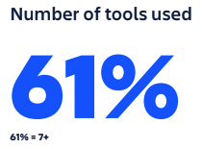
Each team “cooks” software differently
How to make sure we don’t miss information?
With DevOps teams use automation and a bunch of tools
Teams demand flexibility
Flexibility is key when adopting more tools
Source: Atlassian: State of the Developer Report 2022
Notes:
Atlassian: State of the Developer Report 2022
>=5 tools for having an overview of project status

Slide 19
How do we integrate all this?
How to have a unified overview of testing?
Different approaches with different adoption levels
Different frameworks & tools
How to track its impacts on the deliverables managed on the issue tracker being used?

Slide 20
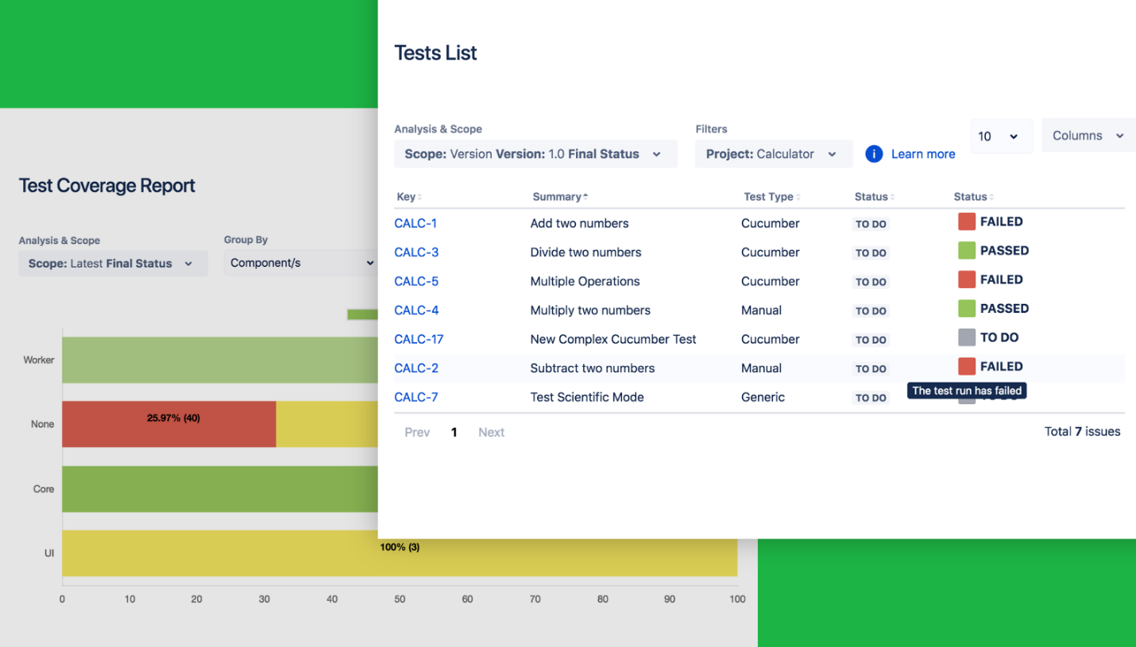
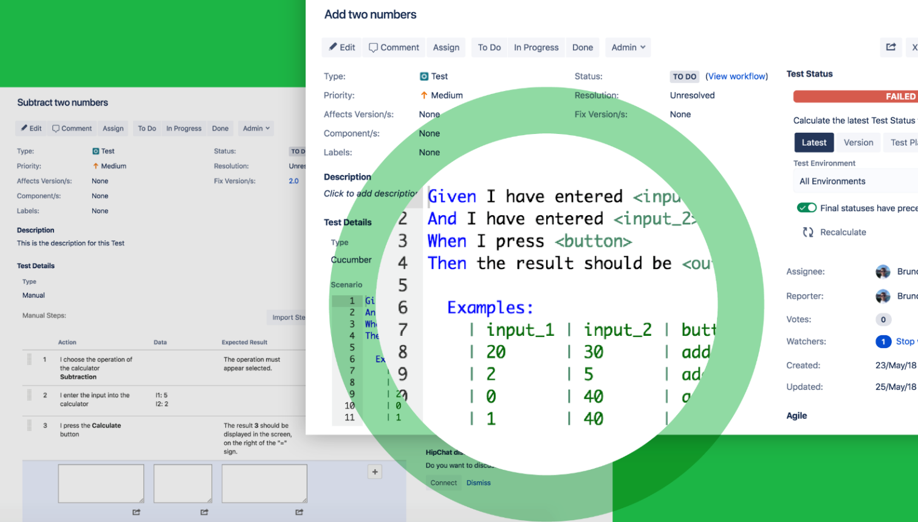
What is Xray?
Test Management App for Jira
Scripted and Exploratory Testing
Organize, Plan & Execute Tests
Report bugs
Test Coverage visibility
Complete traceability
Automation friendly
Single-source of truth, for all team members.

Slide 21
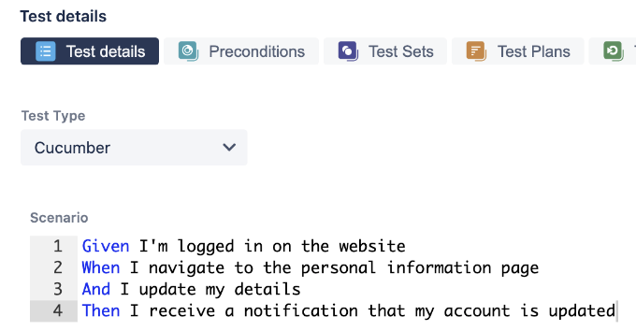
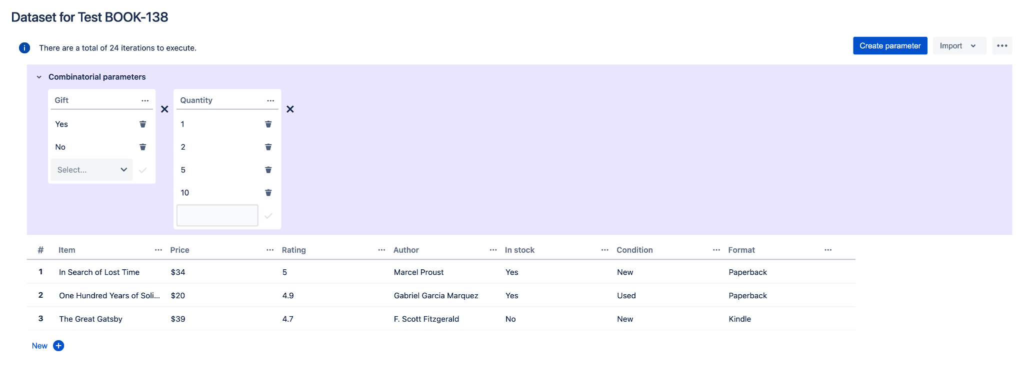
Xray: ”enhanced”, consolidated testing in Jira
Multiple test approaches
BDD
Data-driven testing
Notes:
Use and combine different test approaches (manual scripted test cases, test automation, ET) as they bring different value
Use data-driven testing to increase coverage and test more variations of test ideas
Experiment or adopt BDD; specify test scenarios together in a business DSL
Great omelets are not just made with eggs!

Slide 22
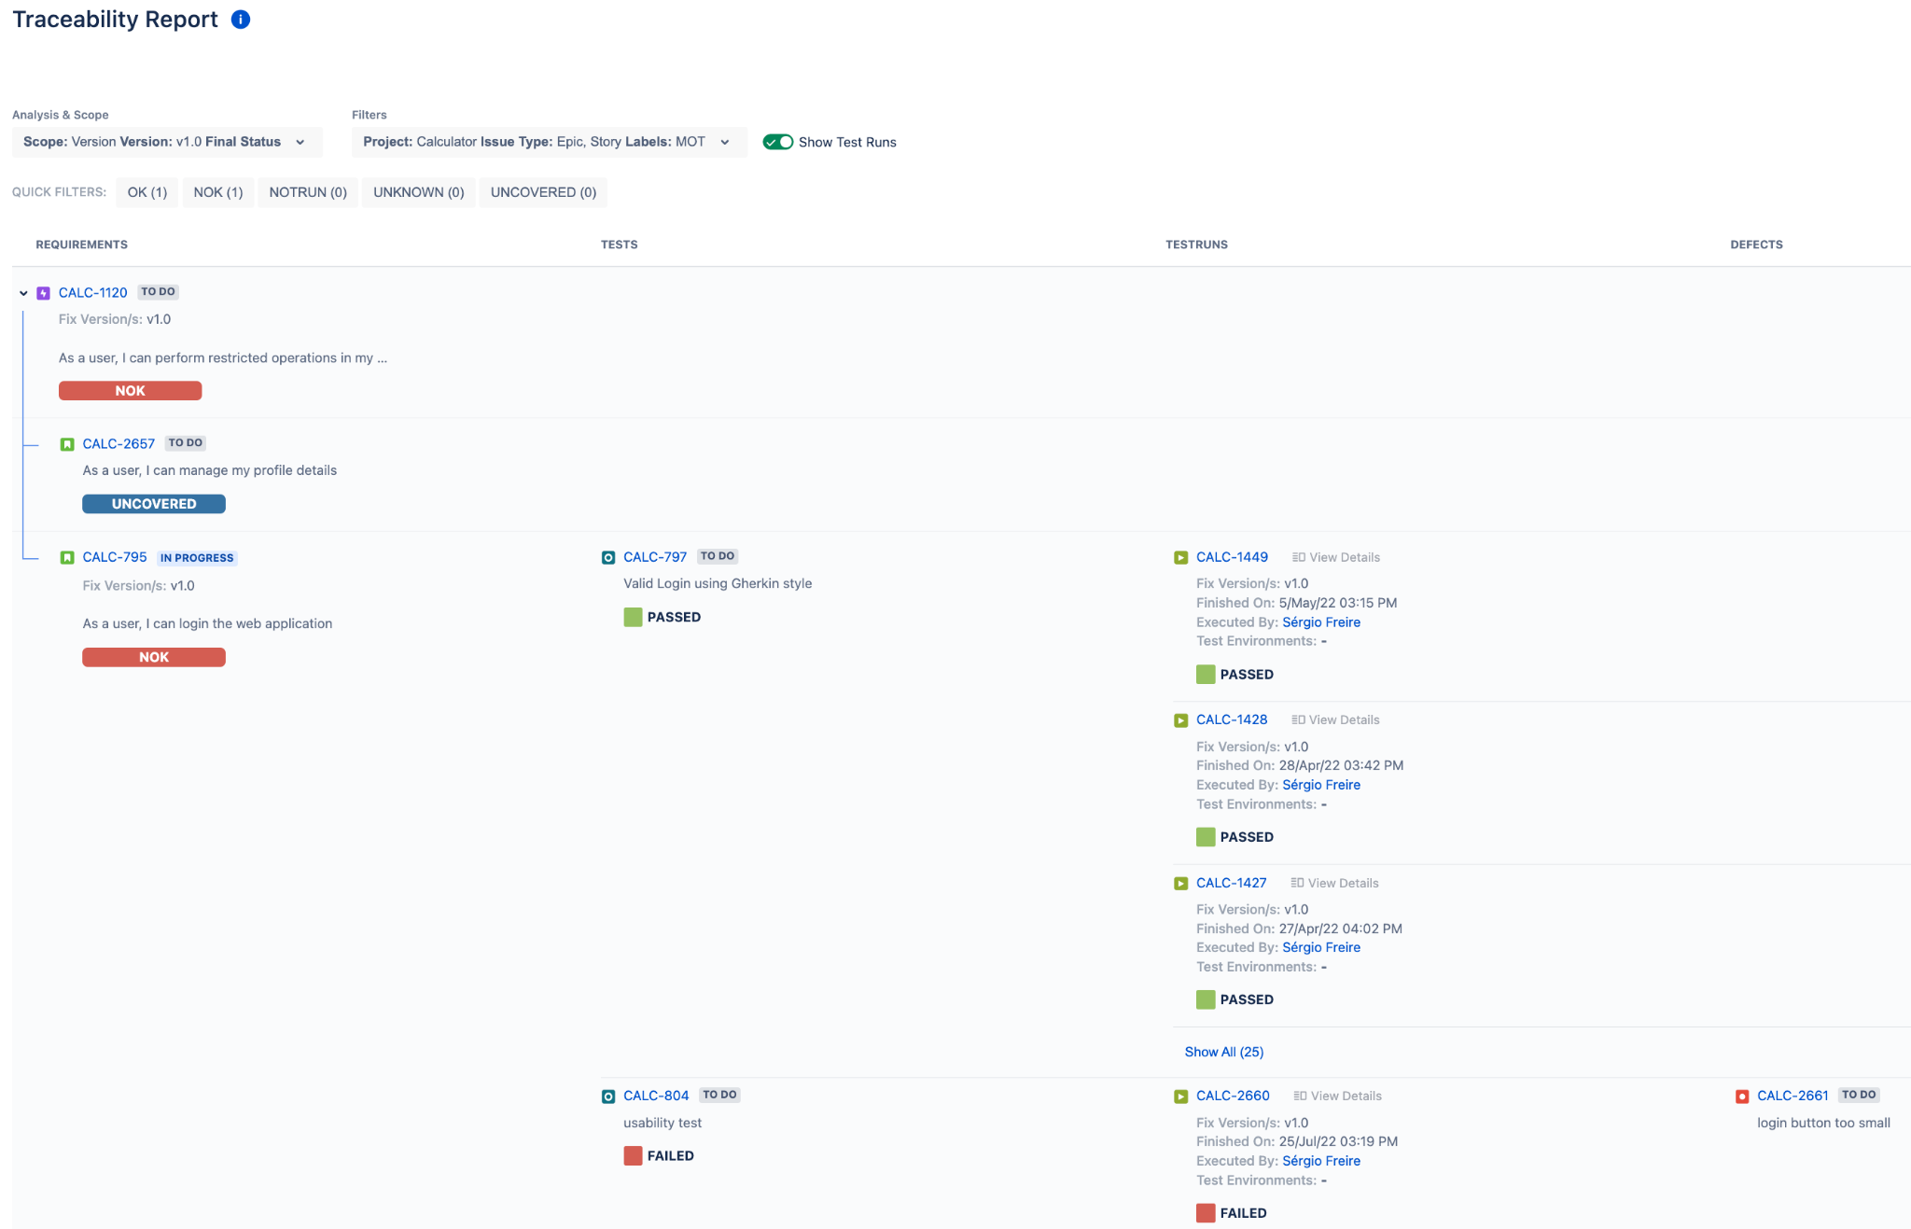
Xray: trace the impacts and the source
Story/requirements ⬄ Tests ⬄Runs ⬄ Bugs
impacts
source (?)
Notes:
Monitor and track code quality
Track and monitor testing results
Enable CI (Continuous Integration)
Track impacts on what matters (the deliverables, the components, your criteria)
Quickly adapt if needed

Slide 23
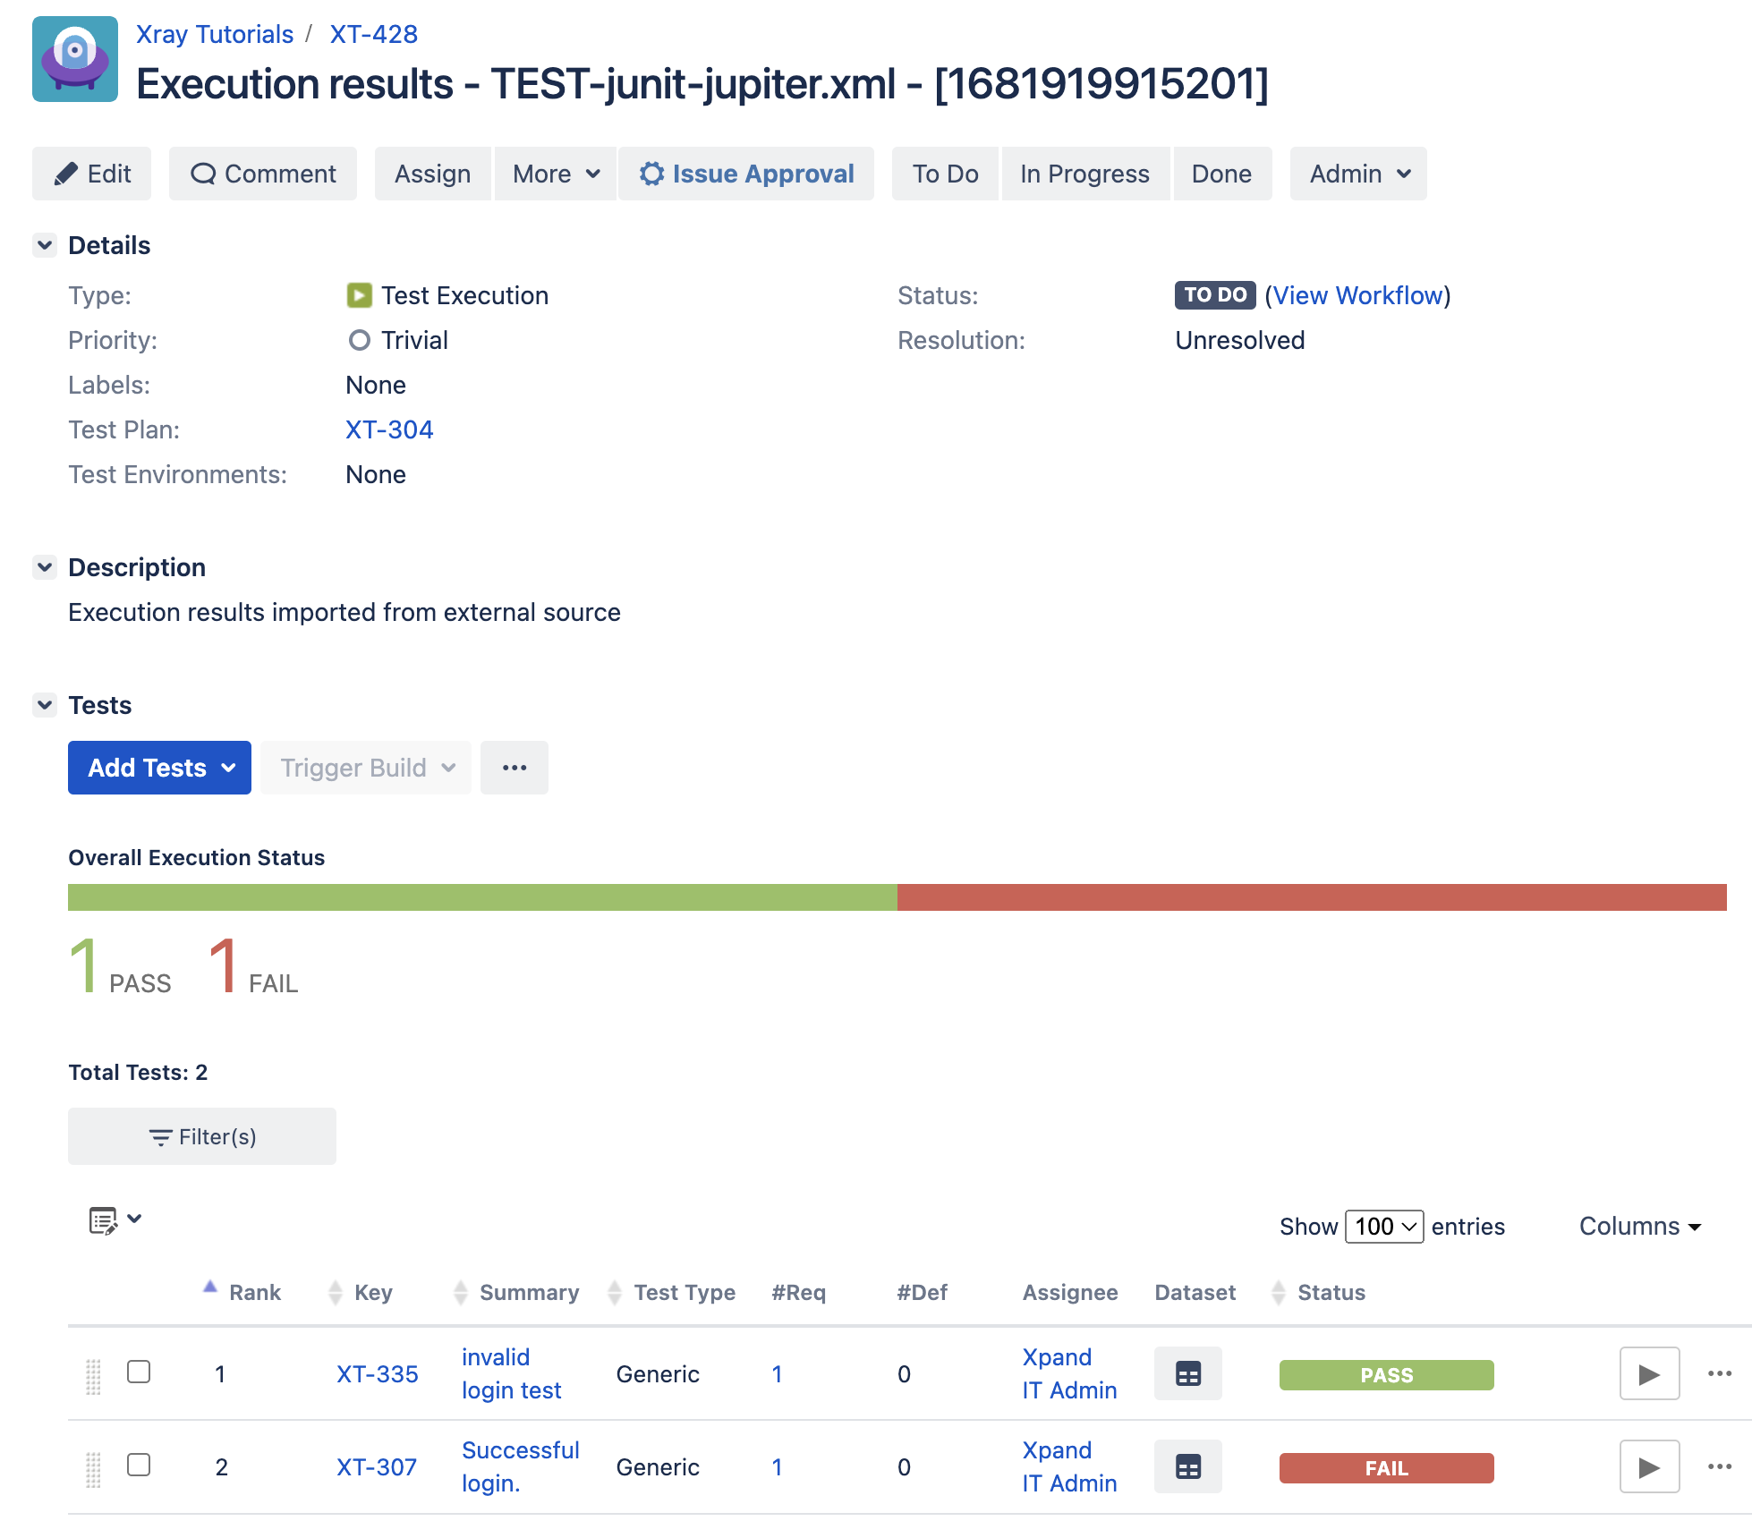
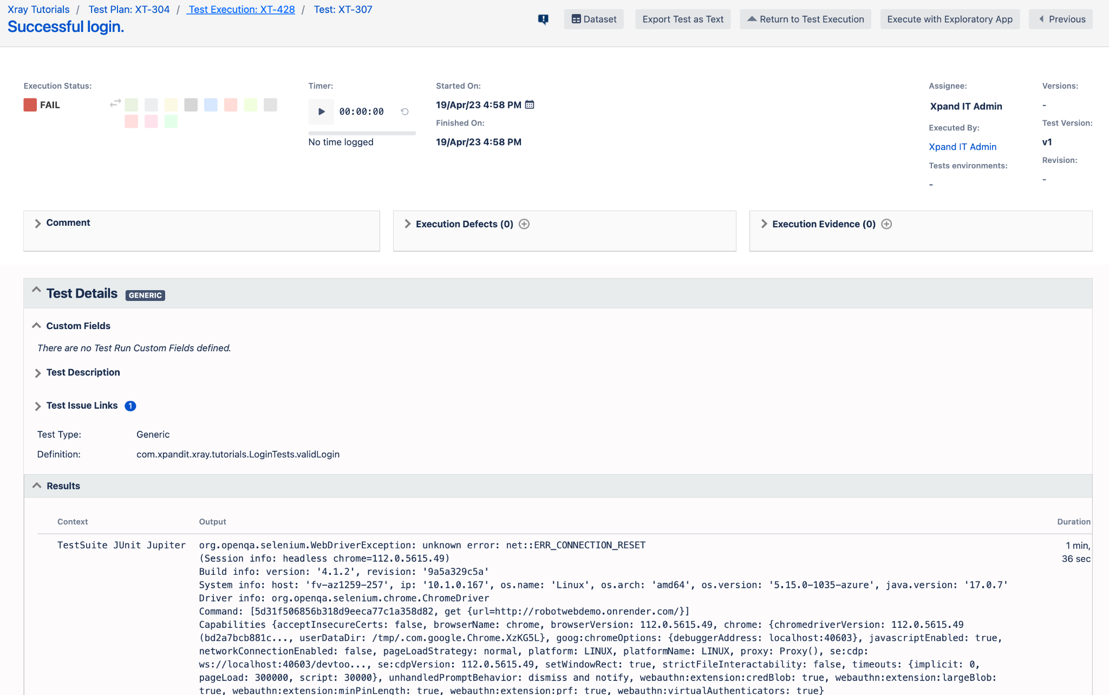
Xray: integration with test automation
Track (have visibility of) test automation results in Jira, using Xray
Alongside other testing effort and available to all team members.

Slide 24
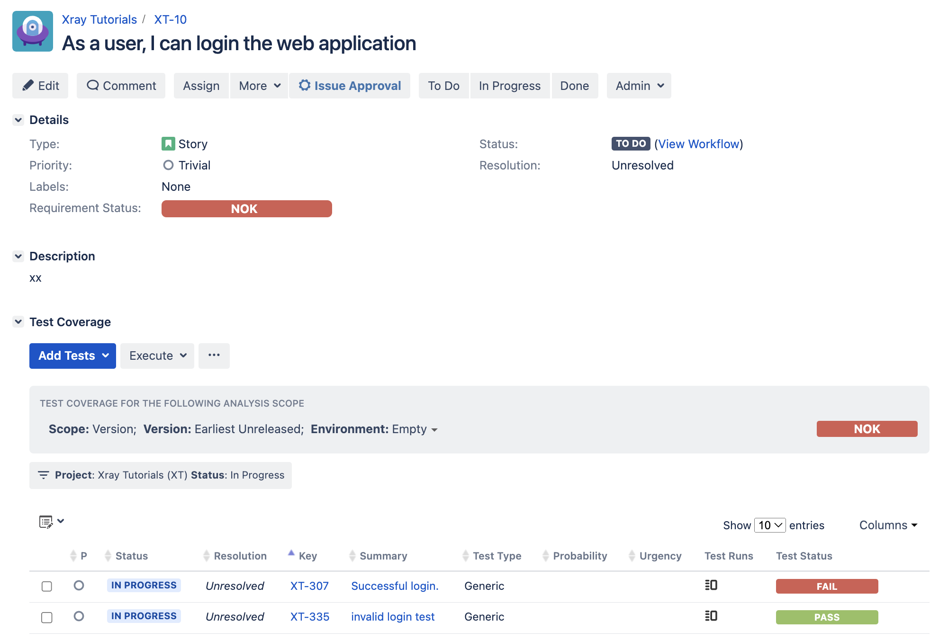
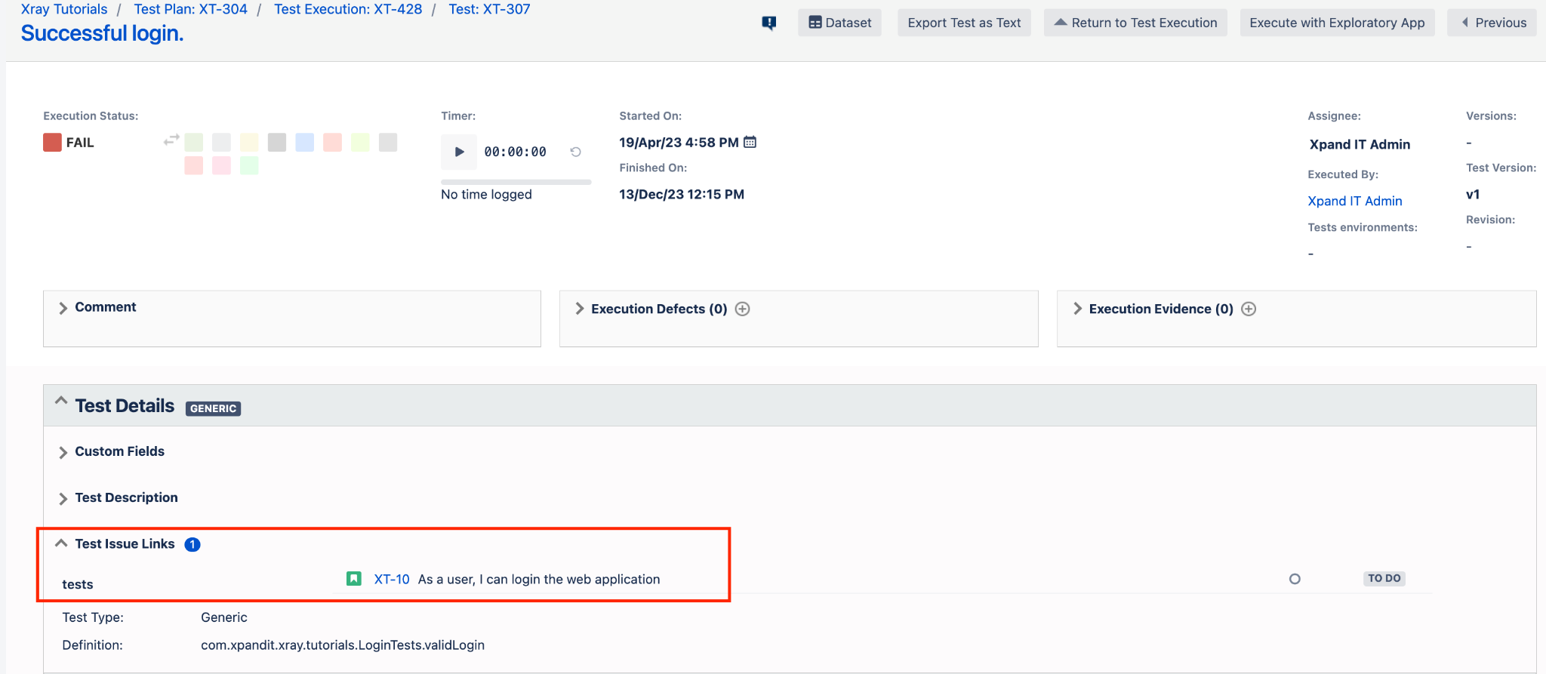
Xray: integration with test automation
2. Track coverage related with test automation
  What “requirements” are covered by automated tests
  What is the status of those “requirements” given the test automation results

Slide 25
Xray: issues coverable with Tests
Story(ies)
Epic(s)
other issue types to be handled as such
Story(ies)

Slide 26

DEMO 1: Spring Tutorial
Unit and integration tests.
We’ll see CI in action:
Fix a bug
Trigger build including tests
    Multiple Java versions
See feedback on PR
Track results in Jira using Xray
https://github.com/bitcoder/tutorial-spring

Slide 27





Project: Spring Tutorial (ST)
Sprint 1
User
Mgmt
Users REST API
ST-2
Landing Page
ST-1
Test Plan
ST-3
Test Execution
JUnit tests
JUnit tests

Slide 28
DEMO 2: A real-life example with “Xray Maven Plugin”
A maven plugin to upload test automation reports to Xray (on Jira). It’s in essence a client library for Xray’s REST API, with some additional logic.
What we’ll see:
Info on the PR
Merge
Make a release with (some level of) confidence
https://github.com/Xray-App/xray-maven-plugin

Slide 29
Xray Maven Plugin: architecture
Mocked using Wiremock
xray-maven-plugin
Jira on-premises, with Xray datacenter
http://customURL
src/test/resources-it
Sample maven projects
Mocked using Wiremock
(used as a HTTPS proxy)
Jira Cloud
with Xray Cloud
https://xray.cloud.getxray.app
Integration tests execute maven itself; each test uses a specific maven project folder for testing purpose
For testing Xray cloud, Wiremock is configured as a HTTPS proxy

Slide 30
Testing challenges
Java 8, 11, 17, 21, 25
2 target apps in fact
Maven “inside” maven
Wiremock for integration tests

Slide 31
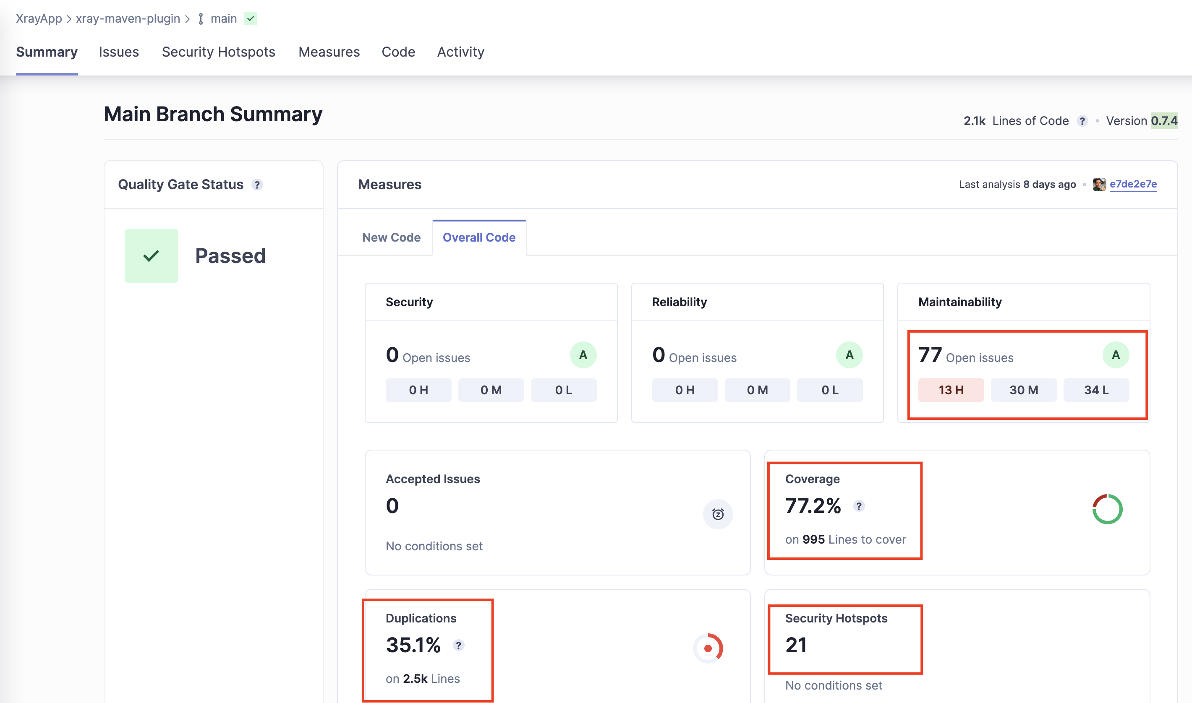
Before refactoring

Slide 32
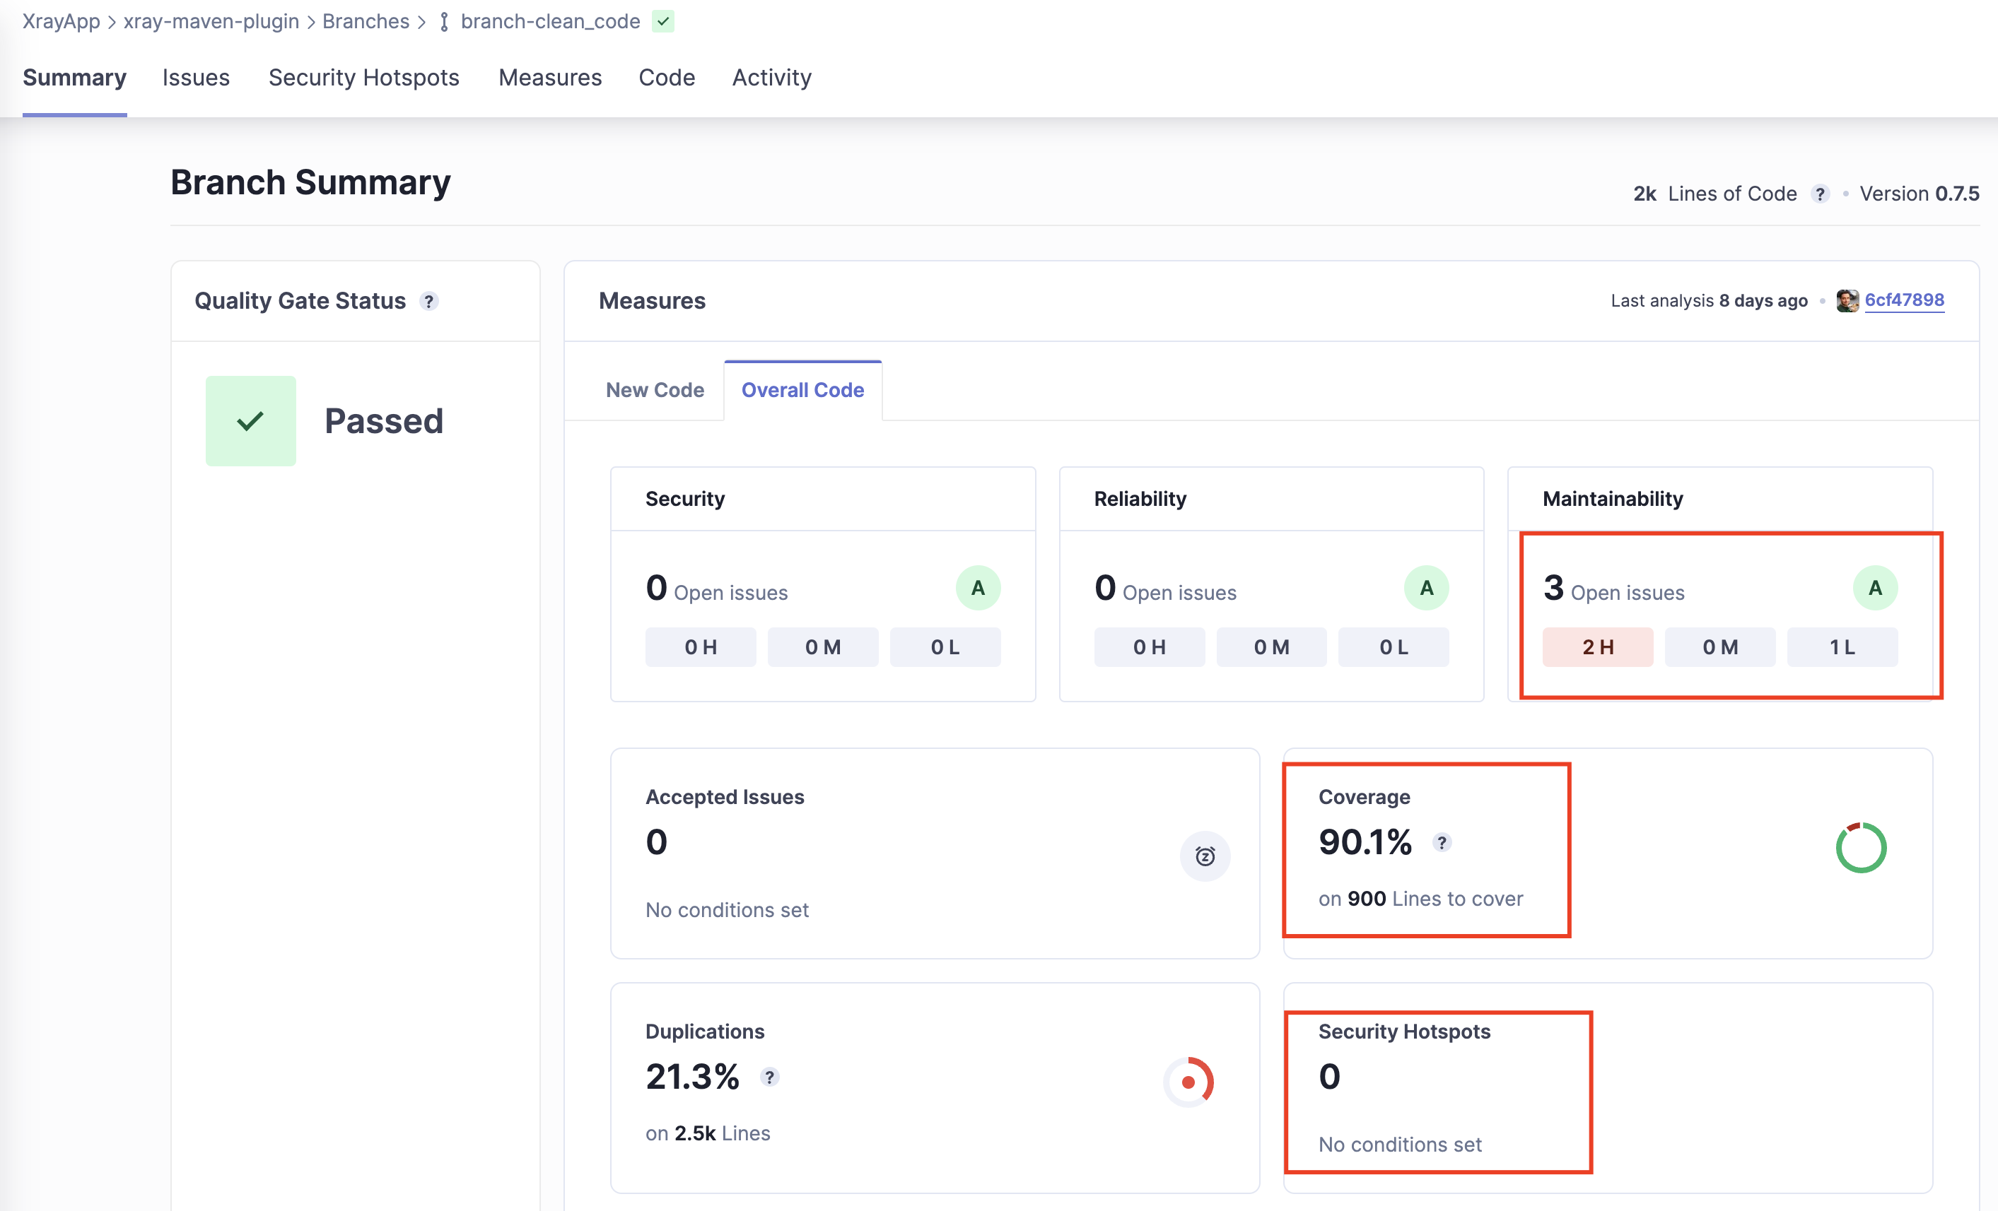
After refactoring and adding more tests
Late refactoring is achievable but it’s harder.

Slide 33
Bonus: Is Test Automation enough?
Can we rely only on the existing test automation set during CI? What may we be missing?

Slide 34

Test automation is a safety net
Image by Ben Hershey, Unsplash
Give us some level of confidence
The more and the thinner, the better
It can break and also have bugs
There will always be gaps
Is the net targeting what matters?! (eg., wind, liquids, bear)
Focused on the known-knowns
Notes:
https://unsplash.com/photos/blue-net-IV--3UEiHlI

Slide 35


Exploratory testing to uncover unknown risks
Where we we are in fact
Where we think we are
Knowledge about the product/system
Unknown
high-risk
Ideal world
no risk
explore
check
@darktelecom
Adapted from Callum Akehurst-Ryan

Slide 36

Space Shuttle Columbia (2001)
Photo by Eric Long

Slide 37
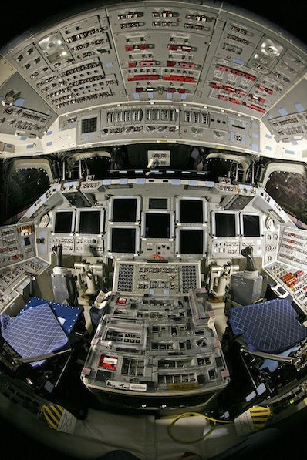

Endeavour (2011)
More than 1,000 toggles!

Slide 38

Sources for complexity (just a few!)
Many…
Input parameters
Values for these parameters
Configurations and/or environments
A lot of scenarios to test!

Slide 39
But can we test this?!
Even with test automation, it can simply be impossible (e.g., time, cost, resources).

Slide 40
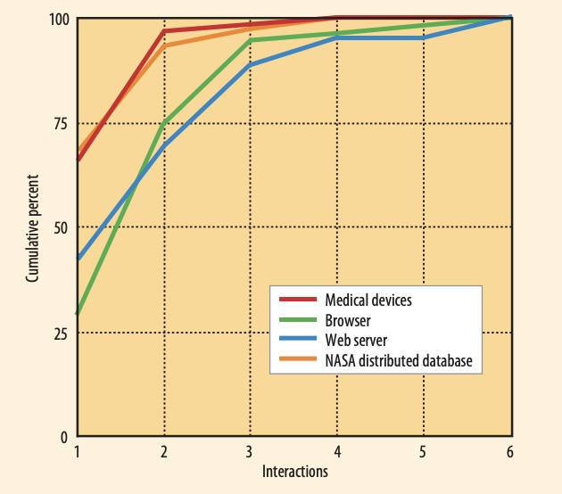
Findings from the field
Most failures are induced by single factor faults or by the joint combinatorial effect (interaction) of two factors, with progressively fewer failures induced by interactions between three or more factors.
NIST studies beginning in 1999 showed that across a variety of domains, all failures could be triggered by a maximum of 4-way to 6-way interactions
Pairwise testing finds about 50% to 90% of flaws but it may not be enough
PRACTICAL COMBINATORIAL TESTING D. Richard Kuhn, Raghu N. Kacker, Yu Lei

Slide 41
Why does it happen?
1-way interaction fault
(pressure=60)
2-way interaction fault
(pressure=1, volume=500)
3-way interaction fault
(pressure=1, volume=500, admin=true)
if (pressure > 50) {
// buggy code
} else {
// ...
}
if (pressure < 10) {
if (volume > 300) {
// buggy code
} else {
// ...
}
} else {
// ...
}
if (pressure < 10) {
if ((volume > 300) && (admin == true)) {
// buggy code
} else {
// ...
}
} else {
// ...
}

Slide 42
What can we do then? Optimize!
Finding more bugs, with less effort, without forgetting what matters.
    Reduce number of tests
    Exclude scenarios/combinations
    Ensure most error-prone combinations are tested
    Ensure critical/important scenarios are tested
    Reduce number of necessary environments (software and/or hardware related)

Slide 43

Notes:
Internal notes:
creating optimized test data and use it with in test automation, with Playwright
show rules, scenarios, fine tuning the algorithm
https://designer.getxray.app/users/42/plans/143/edit
run tests using “npm test”
show code

Slide 44
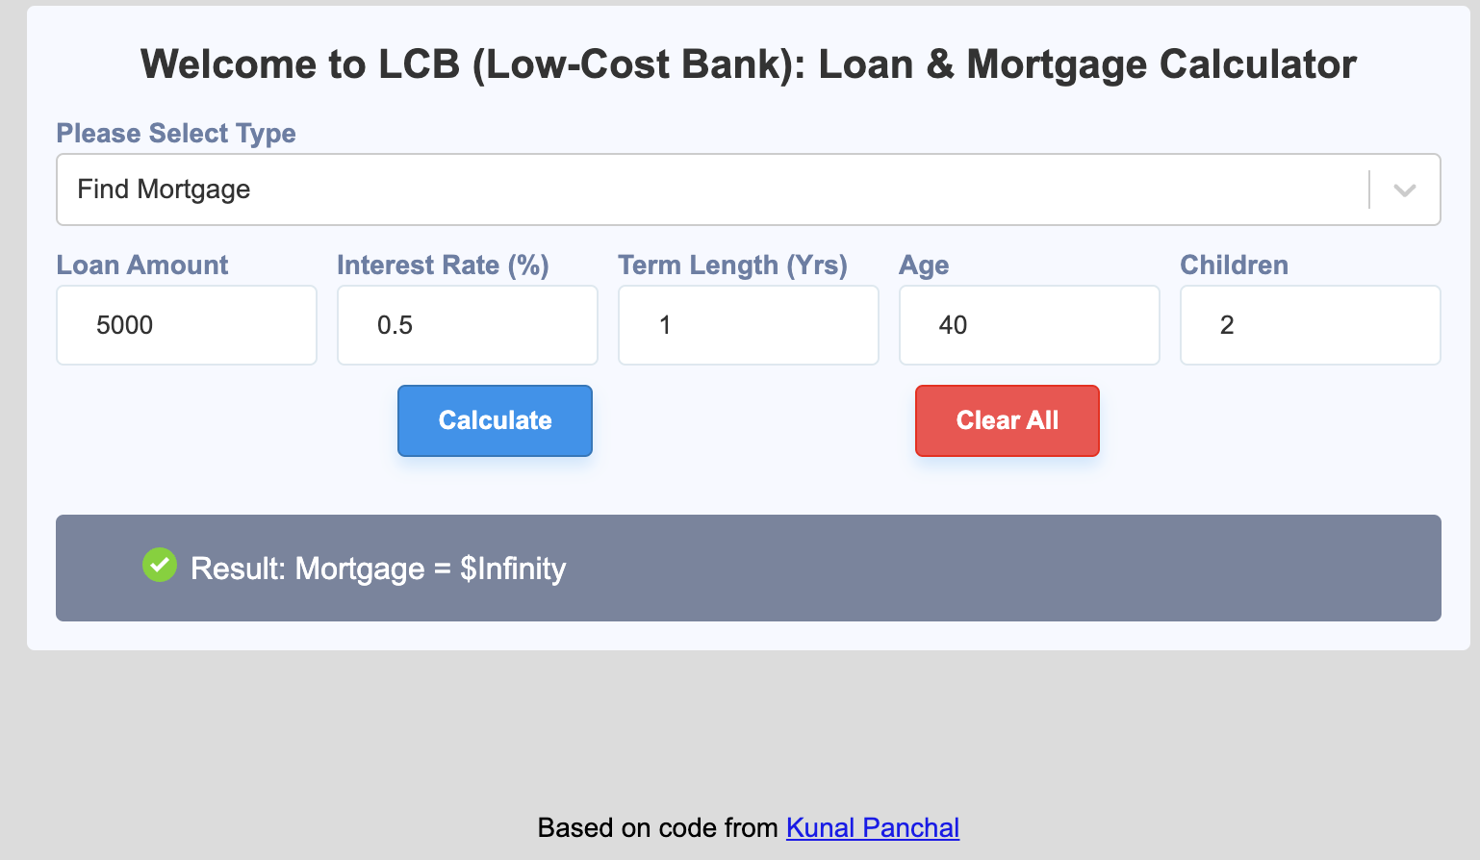
Can you spot the bug?
...
loanAmount = eval(this.state.details.loanAmount);
interestRate = eval(this.state.details.interestRate / 1200);
numberOfMonths = eval(this.state.details.termLength * 12);
result = eval(loanAmount * interestRate) /
(1 - Math.pow(1 + interestRate, numberOfMonths * -1)).toFixed(2);
Notes:
Original code: https://github.com/kunalpan23/SimpleReactLoanAndMortgageCalculator
# fix
numberOfMonths = 12*1;
interestRate = 0.5 / 1200;
result =
eval( (loanAmount * interestRate) /
(1 - Math.pow(1 + interestRate, numberOfMonths * -1))).toFixed(2);
// 835.59

Slide 45
In sum…
To release faster and with confidence, we need CI
CI is a key practice, part of DevOps
Test Automation (TA) is a core part of CI
TA is essential to enable fast feedback loops
Static code analysis as part of CI to ensure code quality
CI is a practice; it needs to be exercised and respected
Testing techniques (e.g., pairwise-testing) and exploratory testing can improve our testing outcomes and efficiency

Slide 46
References
Martin Fowler’s articles
    Continuous Integration
    Continuous Delivery
Wiremock
    https://wiremock.org
Xray (Test Management)
    https://www.getxray.app
    https://docs.getxray.app/display/XRAYCLOUD/TTT%3A+Automation
Agile & Holistic Testing
    https://agiletester.ca
    https://agiletester.ca/quick-tips-for-agile-testing
    https://janetgregory.ca/testing-from-a-holistic-point-of-view/
Pairwise testing, using PICT (open-source tool):
    https://github.com/microsoft/pict
State of the Developer Report 2022
    https://atlassianblog.wpengine.com/wp-content/uploads/2022/03/atlassian-state-of-the-developer-report-pdf.pdf

